Slide 1


Machine Learning
Yelp Local Business Data
Ruchi Singh, Kulwinder Kaur, Ovanes Hovik Mikaelian
Instructor Dr. Jong Wook Woo

Slide 2
Contents
Introduction
Hardware Specification
Dataset Details
Objective
ML algorithms
Pre-requisites
Recommender
Classification
Clustering
Text Analysis
Conclusion
Summary
References

Slide 3
Introduction
The "Business" dataset contains information about local businesses in 11 cities across 4 countries. It contains 70 attributes for each business. Data includes 334,335 rows and 108 columns.
The "Tip" dataset has 591,865 rows across 7 columns. It includes information about the users, no. of likes and comments .
BusinessID
Category
Review Count
Stars
Business Attributes
BusinessID
UserID
Text
Likes

Slide 4
Hardware Specification
Databricks (Spark Machine Learning) – Spark 2.1 (Auto-updating, Scala 2.10)
Memory – 6GB
File System – DBFS (Data Bricks File System)
No. Of nodes – 1 Driver(0.88 cores, 1 DBU), 0 Worker
Azure Machine Learning
Memory - 10 GB
No. of nodes – 1
No. of modules/experiment - 100

Slide 5
Dataset Details
Dataset : Local Business , Tip
Dataset Format : csv
Dataset size : 160MB
Data Source
* https://s3.amazonaws.com/hipicdatasets/yelp_raw_fall_2016.csv
*https://www.yelp.com/dataset_challenge/dataset

Slide 6
Objective
The aim of our project is to utilizing Machine Learning Algorithms based on the dataset and use all possible features to build accurate models using AzureML and SparkML
.
Classification
Clustering
BusinessID
Category
Review Count
Stars
Business Attributes
BusinessID
UserID
Text
Likes
Recommender
Text Analysis

Slide 7
Machine Learning Algorithms Used
* Two class Logistic Regression
* Two class Boosted Regression
* Text analytics using n-gram feature extraction
* Text analysis using unigram TF-DIF feature extraction
* Azure Matchbox Recommender
* Collaborative Filtering Recommender
* K-means clustering

Slide 8
Pre-requisites
AzureML account.
Databricks Community Edition account
Knowledge of Machine Learning Algorithms.
Knowledge of Python and R programming.

Slide 9
Stages of Recommender Modeling
Matchbox Recommender
Collaborative Filtering Recommender In Spark
Data
Preparation
Data
Transformation
Train & Evaluate Models
Data

Slide 10

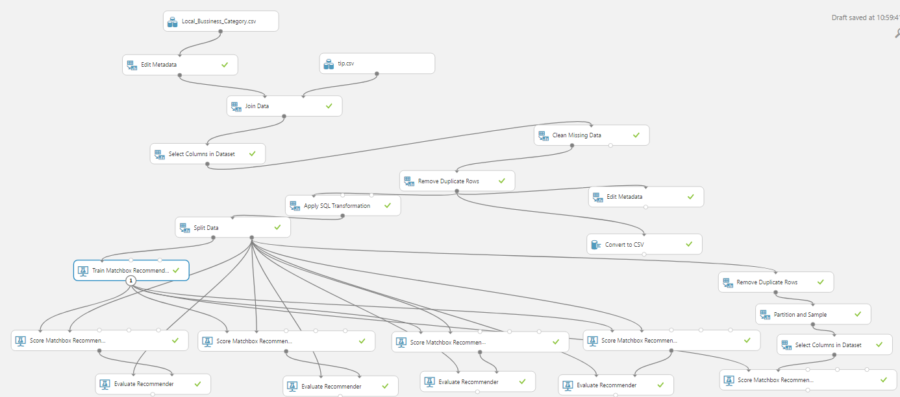
Matchbox Recommender

Slide 11
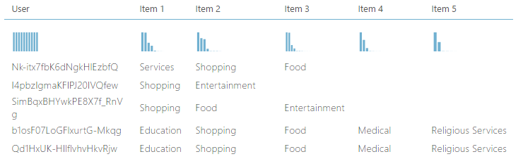

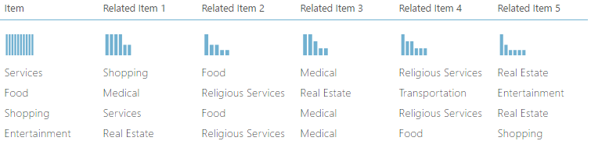
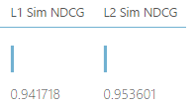
Matchbox Recommender Outcomes
Item (Category) Recommendation
Related Items (Categories)

Slide 12
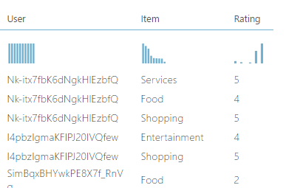
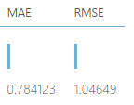
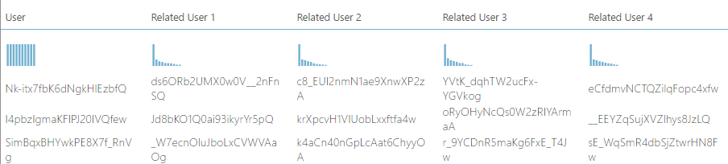
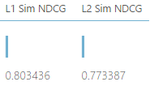
Matchbox Recommender Outcomes
Rating Prediction
Related Users

Slide 13

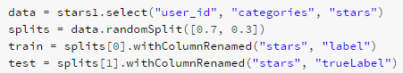



Collaborative Filtering Recommender
Alternating Least Squares (ALS) algorithm * Explicit Feedback

Slide 14
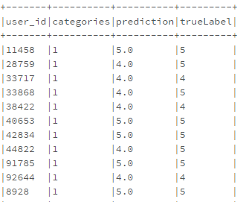
Collaborative Filtering Recommender
RMSE value
0.5958 | 1.0465

Slide 15
Stages of Popularity Prediction
Two Class Logistic Regression
Data
Preparation
Text Preprocessing
Train & Evaluate Models
Implement Logistic Regression In Spark
Data
Two Class Boosted decision Tree

Slide 16
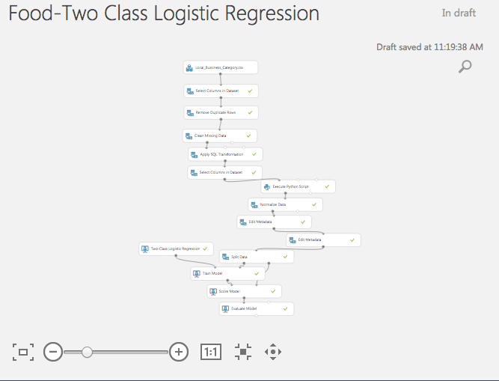
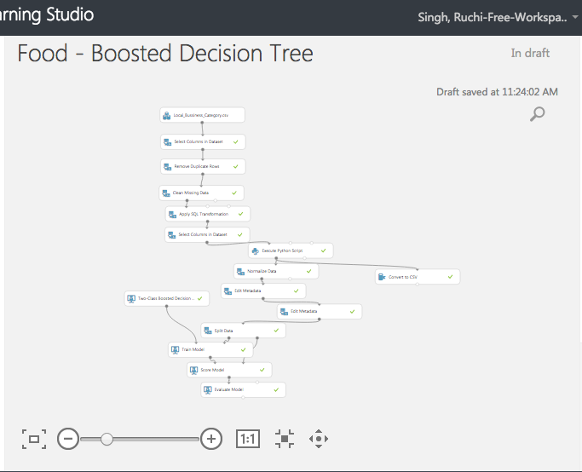
Classification Models
Two Class Logistic Regression
Two Class Boosted Decision Tree

Slide 17
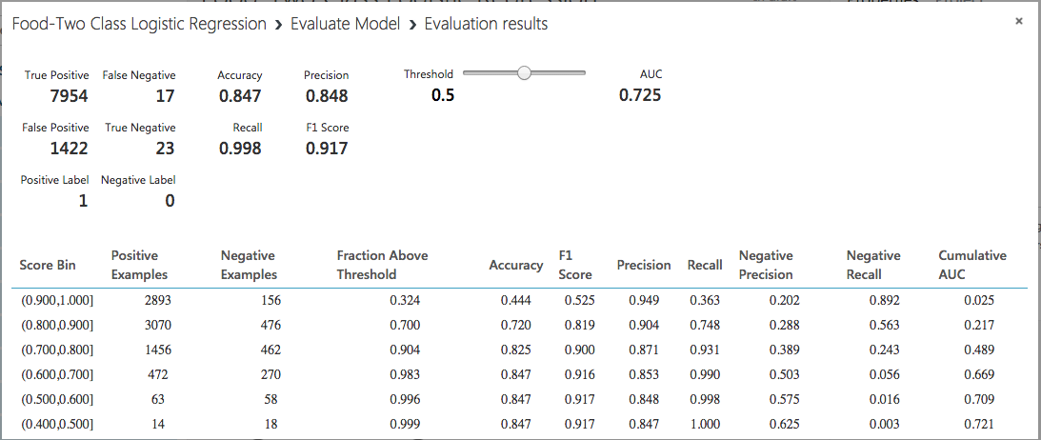
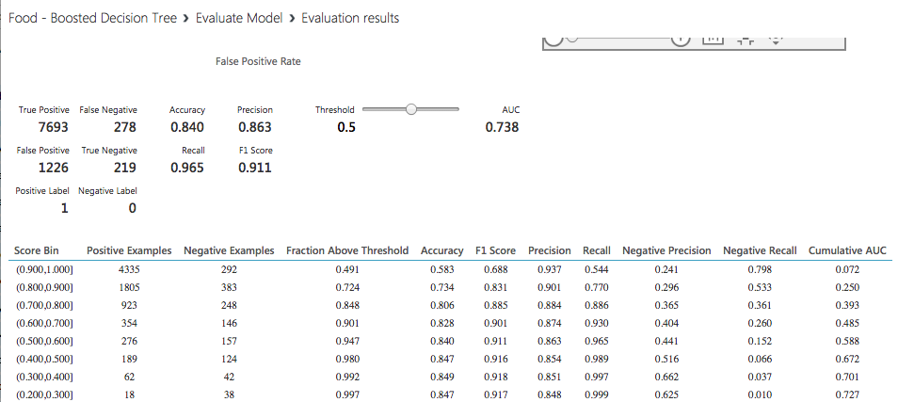
Evaluation Results
Two Class Logistic Regression
Two Class Boosted Decision Tree

Slide 18
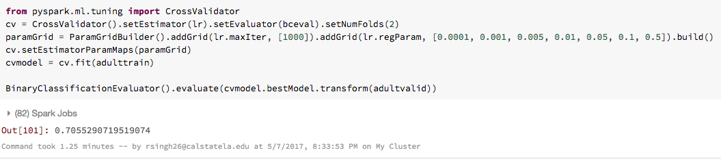
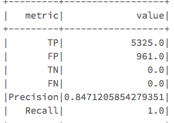
Classification in Spark
AUR values
0.617 | 0.725

Slide 19
Stages of Clustering
K Means
3 cluster
Data
Preparation
Text Preprocessing
Train & Evaluate Models
Implement K-means 5 cluster In Spark
Data
K Means
5 cluster

Slide 20
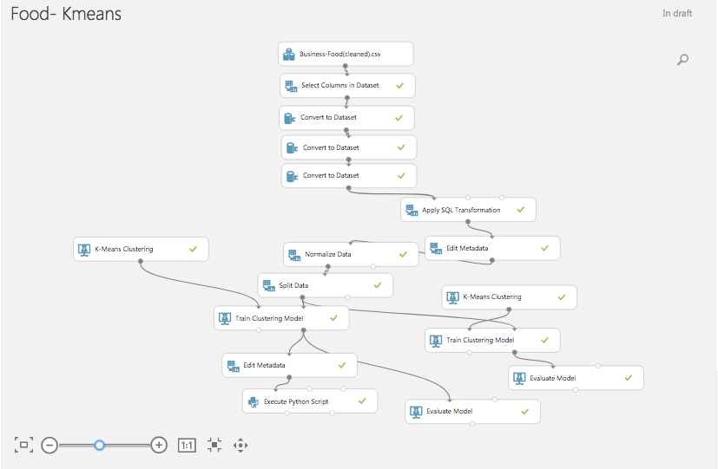
K-means cluster for Food Category

Slide 21
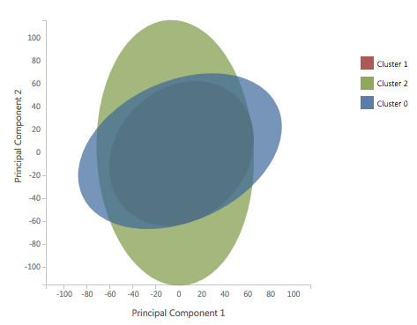
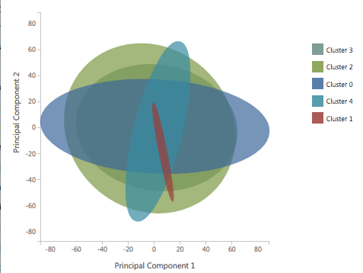
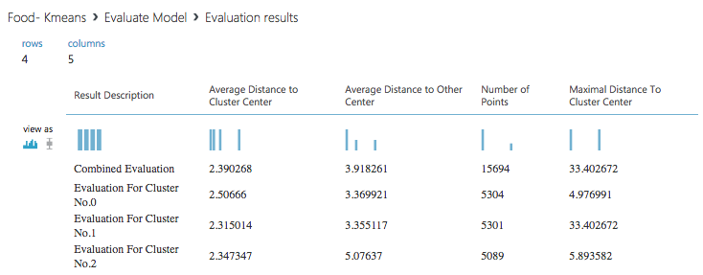
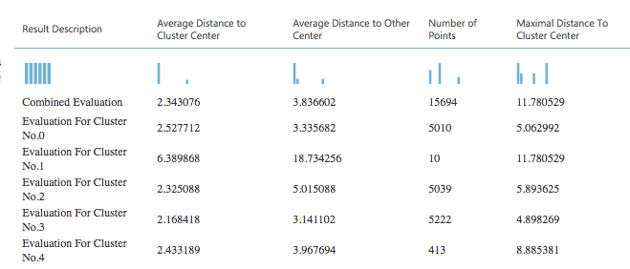
Evaluation of K-means
3 Cluster
5 Cluster

Slide 22
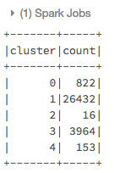
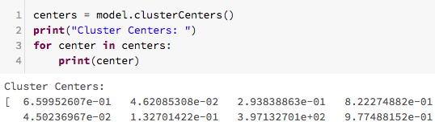
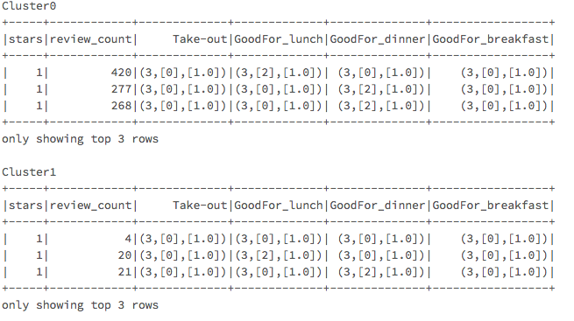
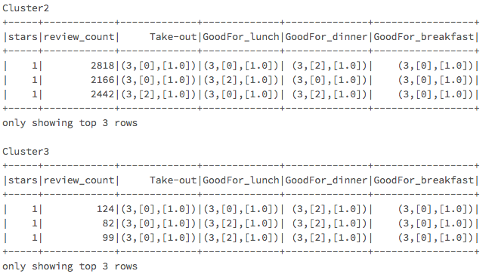
Clustering in Sparks
Cluster Center Distance
9.77 | 11.72

Slide 23
Stages of Text Analysis
N-gram TF Feature Extraction
Data
Preparation
Text Preprocessing
Train & Evaluate Models
Implement Classification In Spark
Data
Unigram TF-IDF Feature Extraction

Slide 24
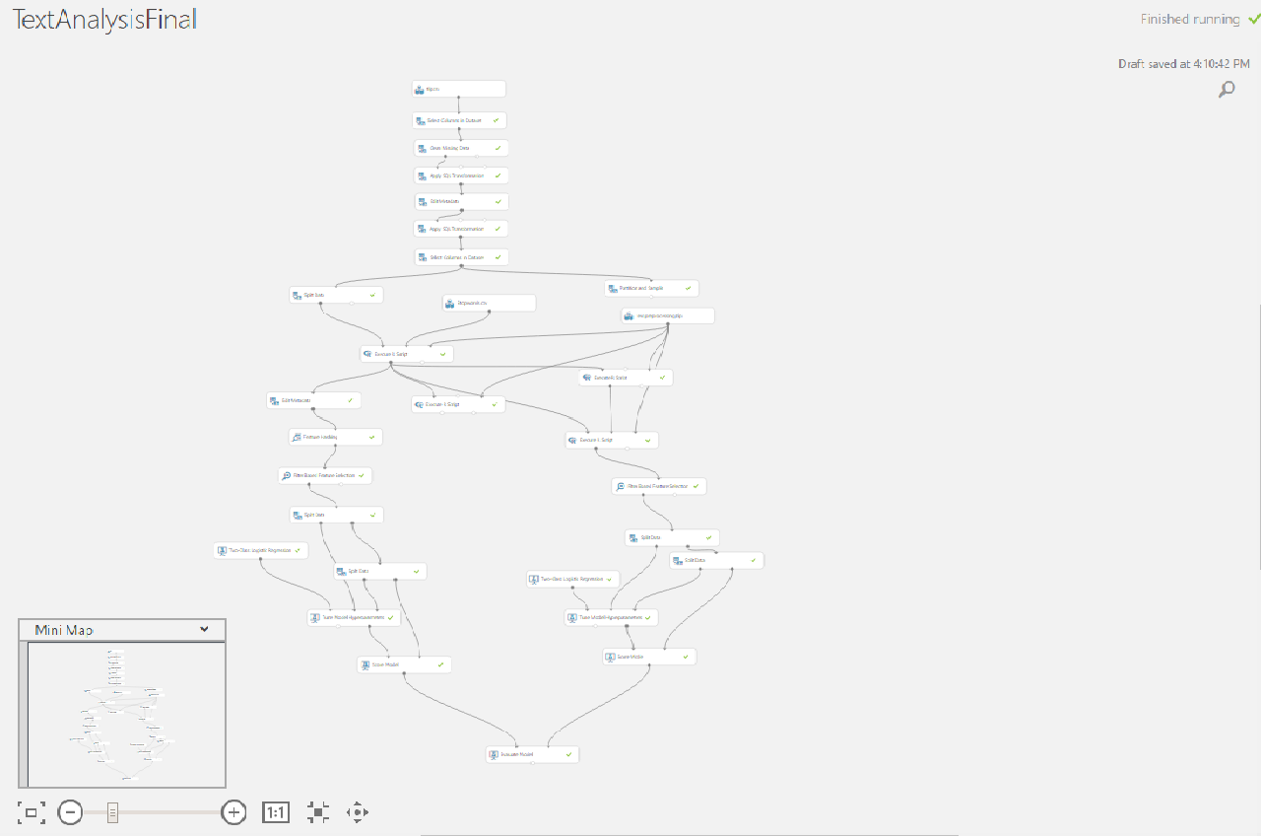
Text Analysis

Slide 25
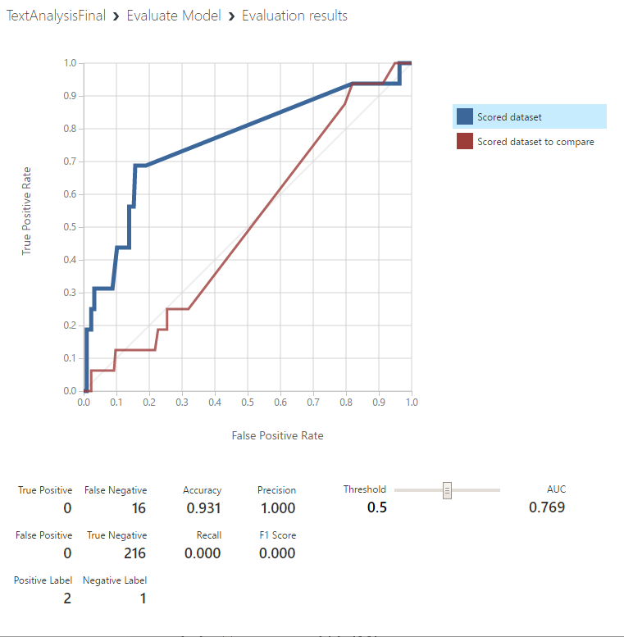
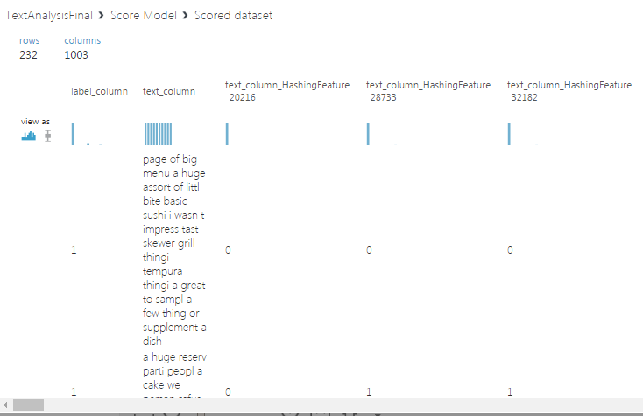
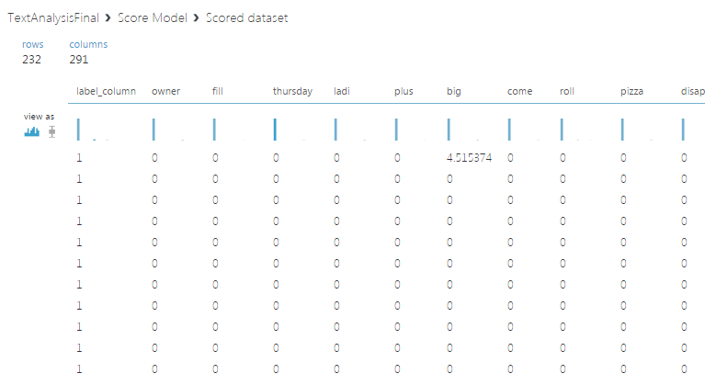
Text analysis outcomes

Slide 26
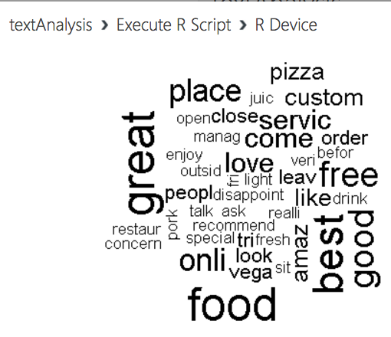
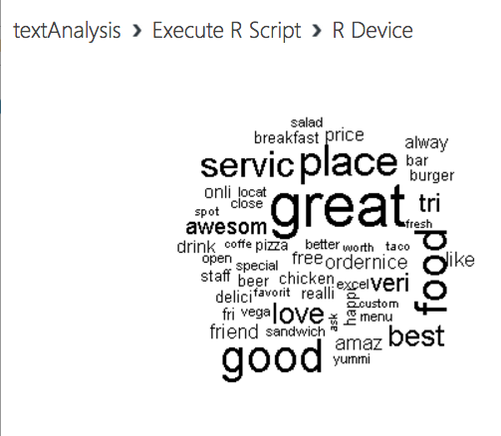
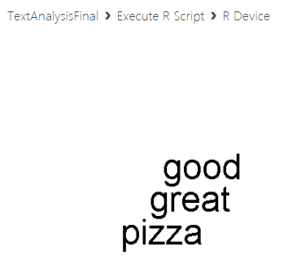
Word Cloud

Slide 27
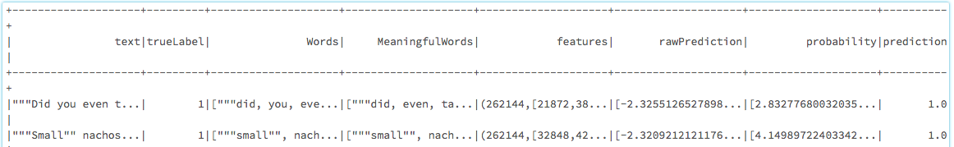
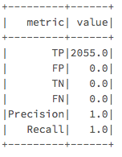
Text analytics in SparkML
AUR values
0.769 | 1.0

Slide 28
Conclusion
Azure | Evaluation | Spark | Evaluation
Matchbox Recommender | 1.046 | Collaborative Filtering Recommender | 0.595
Two Class Logistic Regression | 0.725 | Two Class Logistic Regression | 0.617
Two class Boosted Decision Tree | 0.738
K-means 3 cluster | 33.4 | K-means 5 cluster | 9.77
K-means 5 cluster | 11.78
N-gram | 0.76 | N-gram | 1
Uni-gram | 0.5

Slide 29
Summary
Recommender – The recommendations can be used to find target customers to promote business and helps in providing suggestions.
Popularity Prediction – The classification of business helps to improve popularity amongst customers.
Clustering – The business are logically grouped based on their range of review counts based on their attributes.
Text Analysis – Helps to understand customer sentiment and satisfaction of a business.

Slide 30
References
Microsoft DAT202.3x Implementing Predictive Analytics with Spark in Azure HDInsight
Microsoft's DAT203x, Data Science and Machine Learning Essentials
How to choose algorithms for Microsoft Azure Machine Learning - https://docs.microsoft.com/en-us/azure/machine-learning/machine-learning-algorithm-choice
Text Analysis - https://gallery.cortanaintelligence.com/Experiment/
Databricks Spark Data Engineers -https://docs.microsoft.com/en-us/azure/machine-learning/machine-learning-algorithm-choice

Slide 31
Thank You!
Q&A

